Slide 1
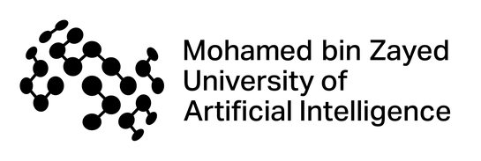




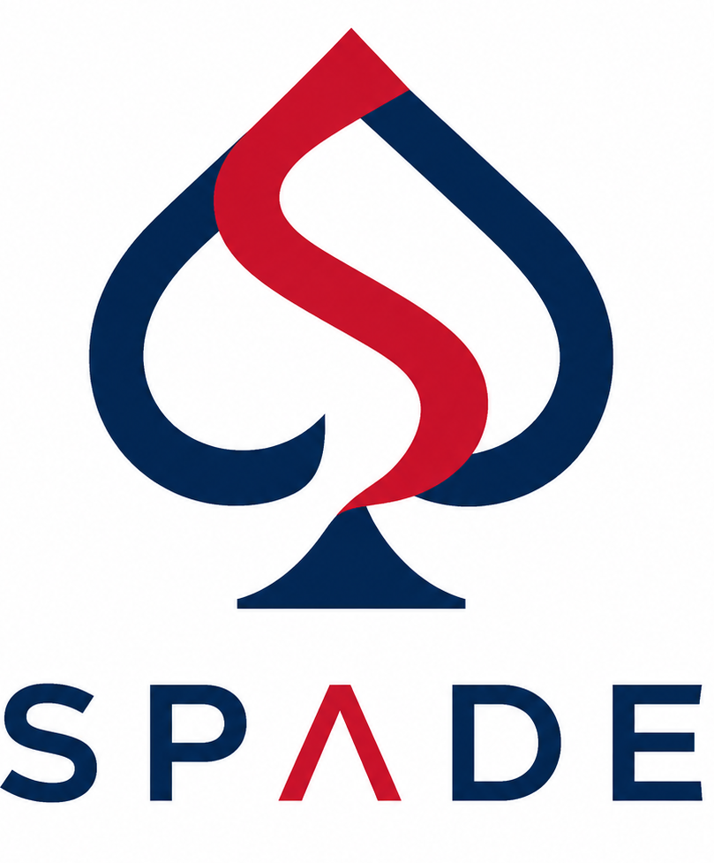
Support-Proximity Augmented Diffusion Estimation for Offline Black-Box Optimization
Yonghan Yang* [1], Ye Yuan* [1,2,3], Zipeng Sun [2,3], Linfeng Du [2,3],
Bowei He [1], Haolun Wu [2,3], Can Chen [3,4], Xue Liu [1,2,3]
[1] MBZUAI [2] McGill University [3] Mila - Quebec AI Institute [4] Amazon AGI * equal contribution
Notes:
Hi, today I’ll present SPADE. It’s an offline BBO framework that models the forward score likelihood with a calibrated diffusion surrogate, then uses support proximity to make optimization conservative in low-density regions.

Slide 2



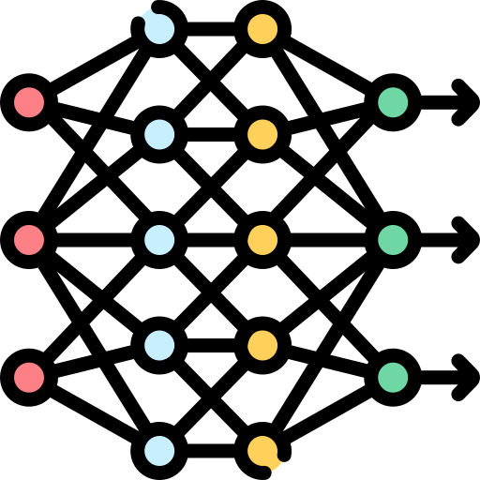

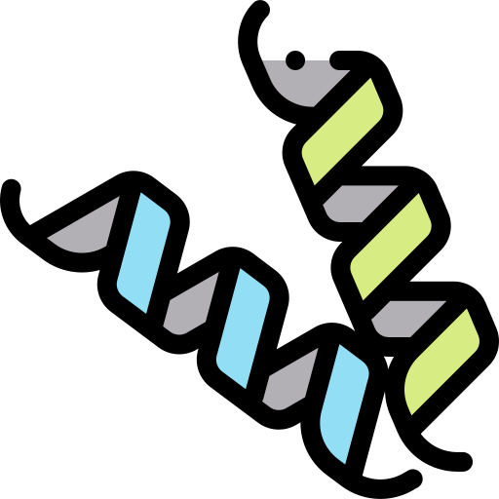




Background
Method
Experiments
Offline black-box optimization searches best design with fixed dataset and no new evaluations.
Materials
Molecules
Historical Data
Offline Model
Design
$${argmax}_{x} f\left(x\right)$$
Hyperparams
···
Notes:
Offline black-box optimization is useful whenever evaluating the true objective is expensive, slow, risky, or impossible, but historical data already exists

Slide 3
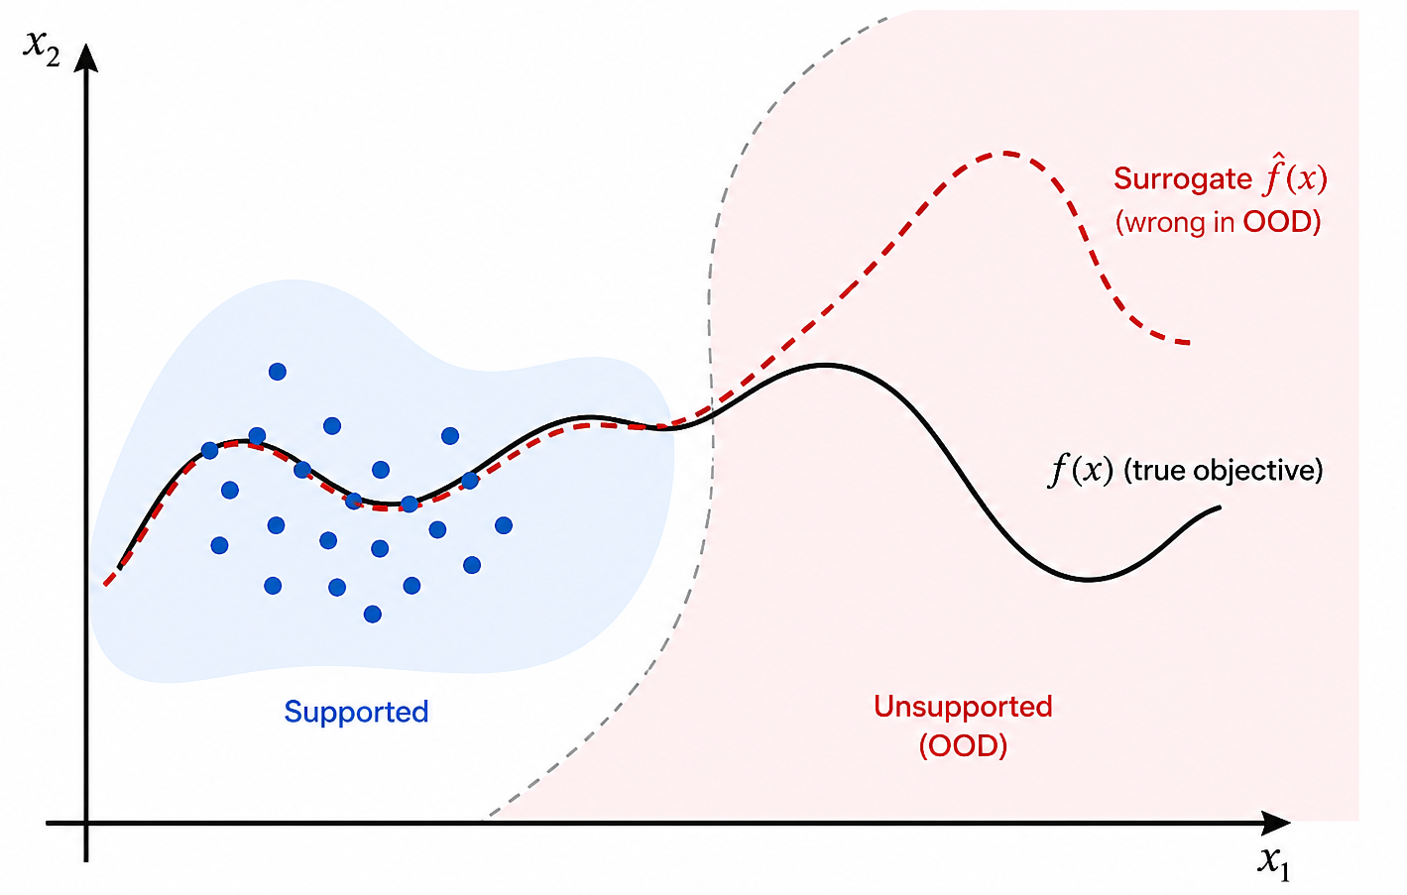
Background
Method
Experiments
Offline black-box optimization searches best design with fixed dataset and no new evaluations.
Optimizer exploits surrogate overestimations far from data manifold.
Notes:
But the optimizer pushes the surrogate into unsupported regions, where high predicted scores may simply be hallucinations. SPADE is designed for this failure mode.

Slide 4
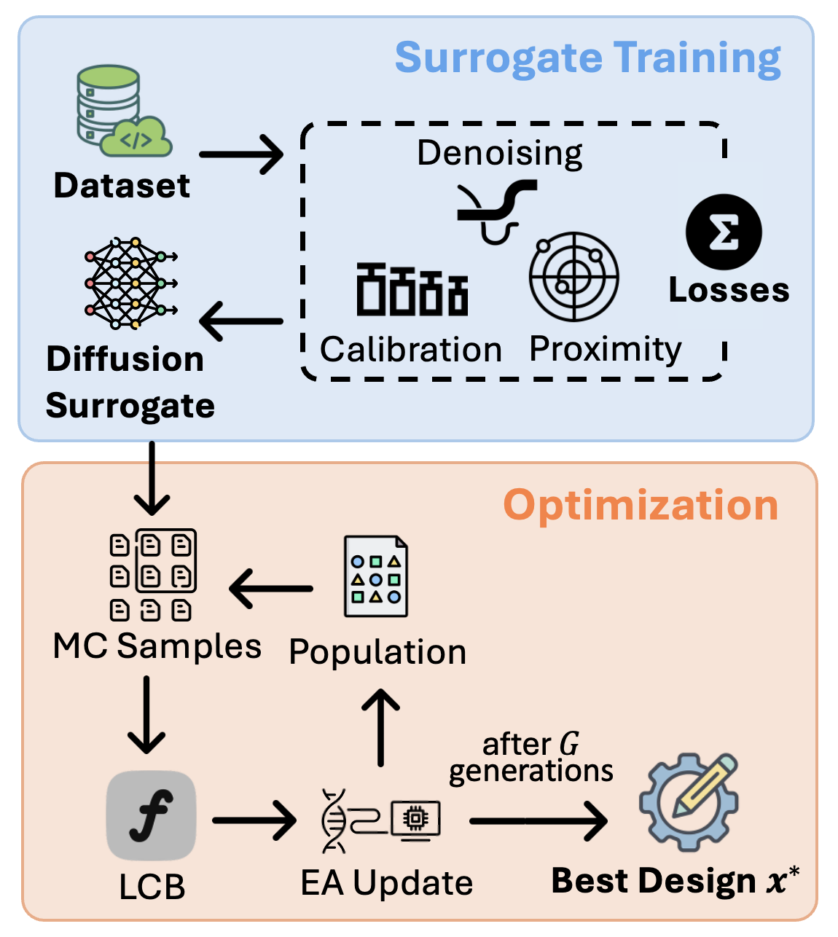
Background
Method
Experiments
SPADE trains a calibrated, support-aware diffusion surrogate on offline design–score data.
It then uses MC sampling, LCB scoring, and evolutionary updates to find the best design.
Notes:
SPADE has two mechanisms. First, the conditional diffusion surrogate calibrated with moment matching and rank consistency. Second, k-nearest neighbors calibration to measure how well a candidate is supported by the offline dataset. Designs far from data manifold has reduced predicted mean and increased uncertainty. The final search maximizes a lower confidence bound, so unsupported candidates become unattractive even if their raw predicted score is high.

Slide 5

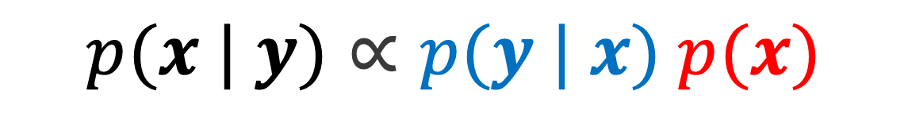
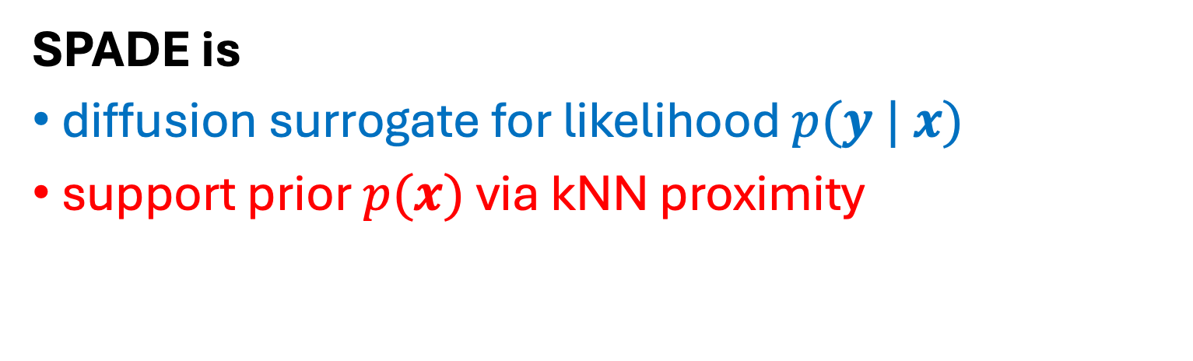
Ã(x) ≈ A(μ, σ) + κ log p̂_knn(x)
Background
Method
Experiments
$$p(x | y)∝p(y | x) p(x)$$
SPADE is
diffusion surrogate for likelihood $p(y | x)$
support prior $p(x)$via kNN proximity
Acquisition $≈$ predicted utility $+$ data-support prior
Notes:
A good design should be: predicted to perform well, and appear supported by the offline dataset. In terms of Bayes’ rule, it depends on both the score likelihood and the design prior, which SPADE models with diffusion surrogate and support proximity calibration. We prove SPADE’s acquisition is approximately the original utility plus a kNN log-density term. So candidates far from the dataset receive a lower acquisition score, even if the surrogate predicts a high mean.

Slide 6
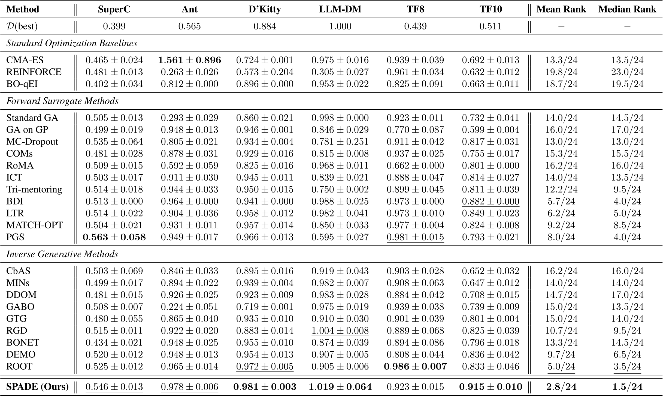
Background
Method
Experiments
SOTA on benchmarks: mean & median ranks are 2.8 and 1.5 out of all 24 methods
Notes:
SPADE has the best overall ranking among 24 methods. On normalized maximum score, it reaches top-two performance on five of six tasks.

Slide 7
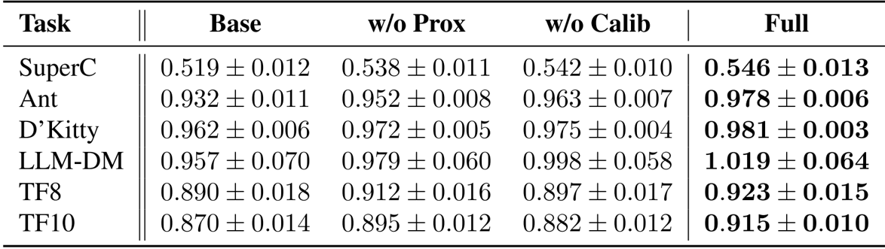
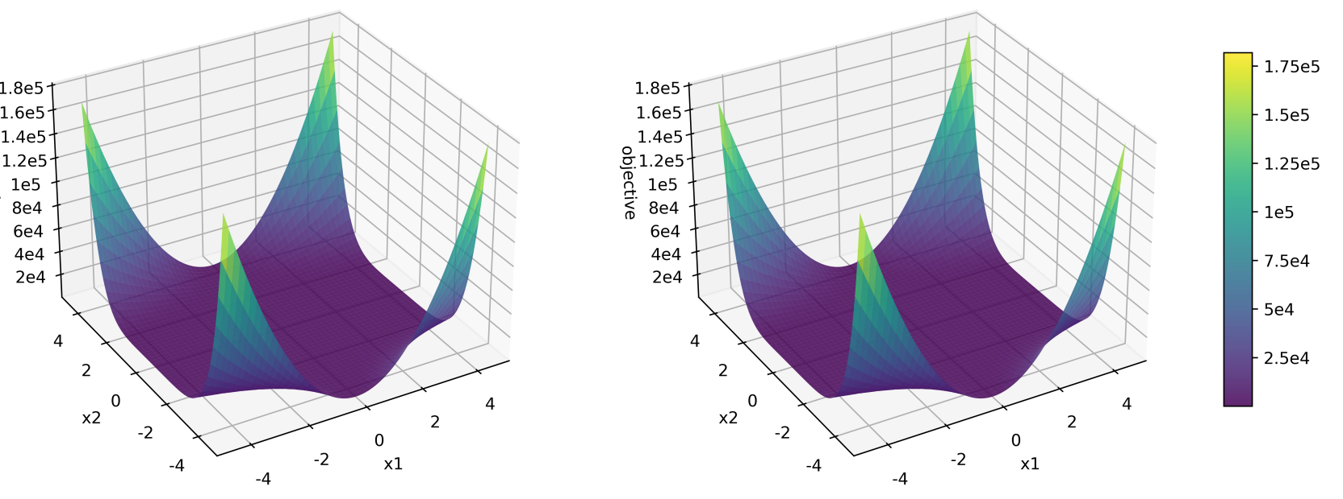
Background
Method
Experiments
SOTA on benchmarks: mean & median ranks are 2.8 and 1.5 out of all 24 methods
Ablation validates regularization design: both components are necessary
Observation on synthetic functions: SPADE recovers global structure.
Notes:
Ablation shows that calibration and support proximity both help, and taken together, the full SPADE method excels. Empirical evidence on many synthetic functions also suggest that SPADE captures the structure of the objective function overall.

Slide 8



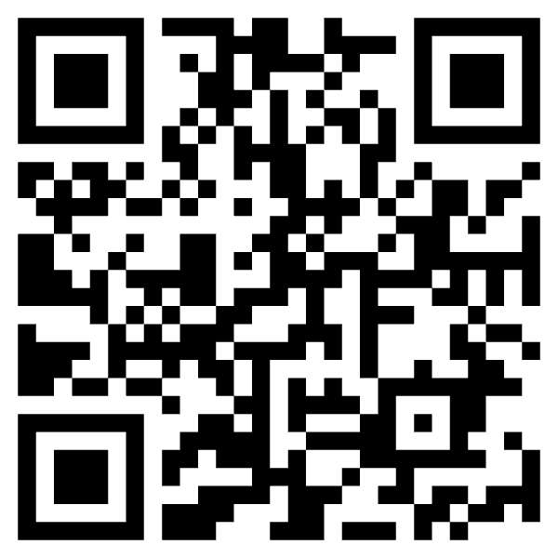

Thanks!
Paper
Code

